Slide 1
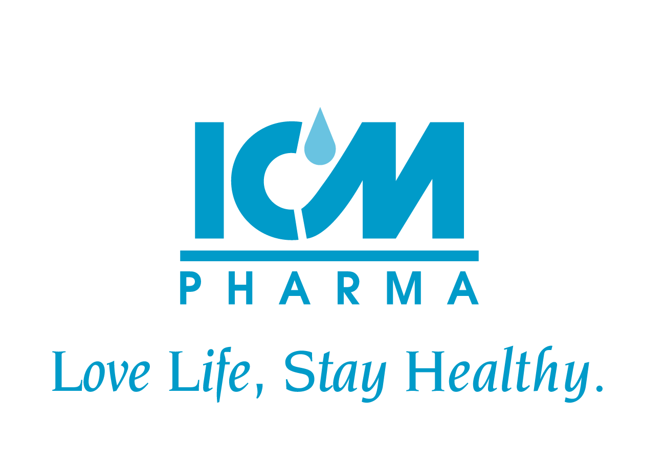
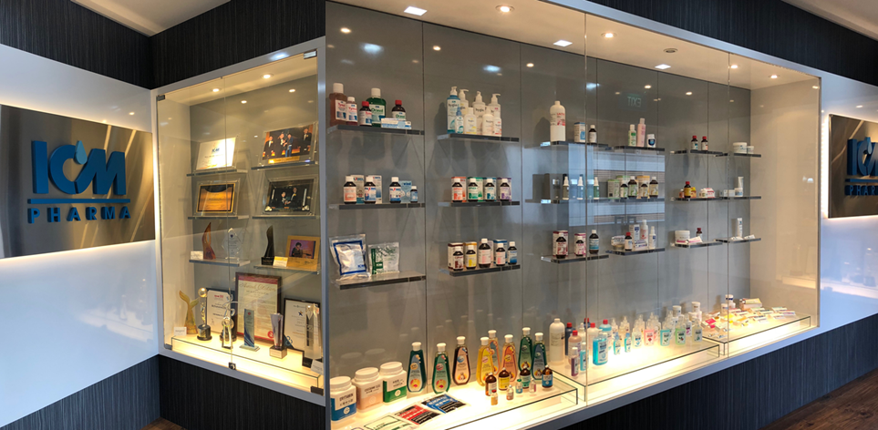
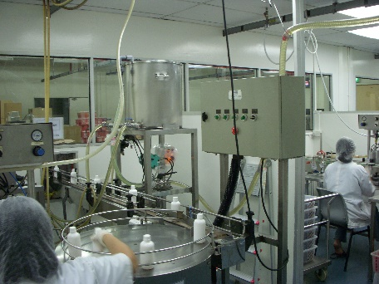
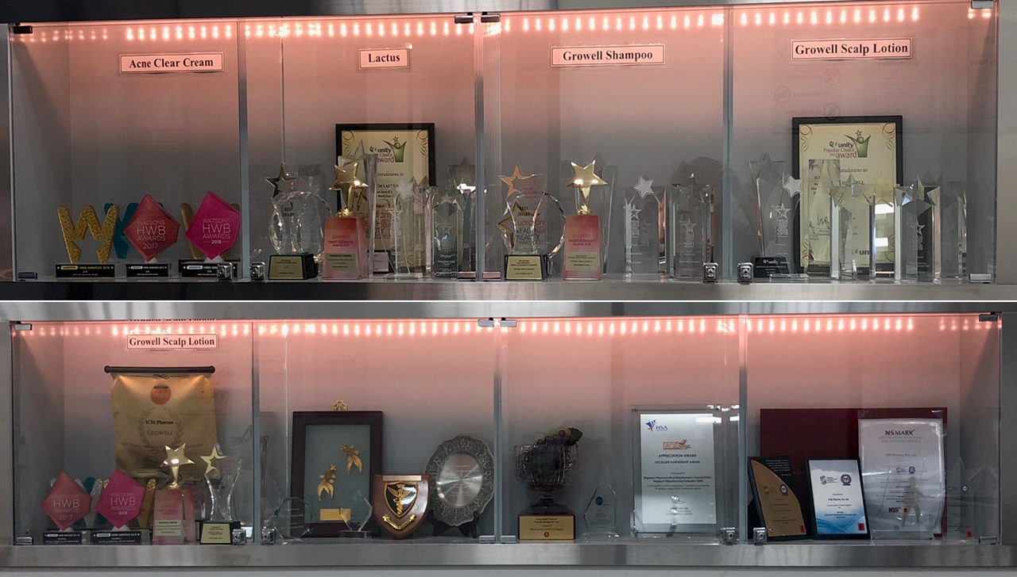
ICM Group Estd. 1970
50th year of service in quality healthcare
State of the art cGMP certified Pharmaceutical Manufacturing in Singapore!
One stop centre with a wide range of offerings, from Minor ailment specialties to high end therapeutics (Including CNS & Oncology)
Unique & Technically value added differentiation making ICM a household name
As a home grown Pharmaceutical Manufacturer,
“We wish to hold the Singapore flag high on the Global Map”
We thank you for making us the No. 1 in many leading sectors!
“We are committed to serve you even better”

