Slide 1
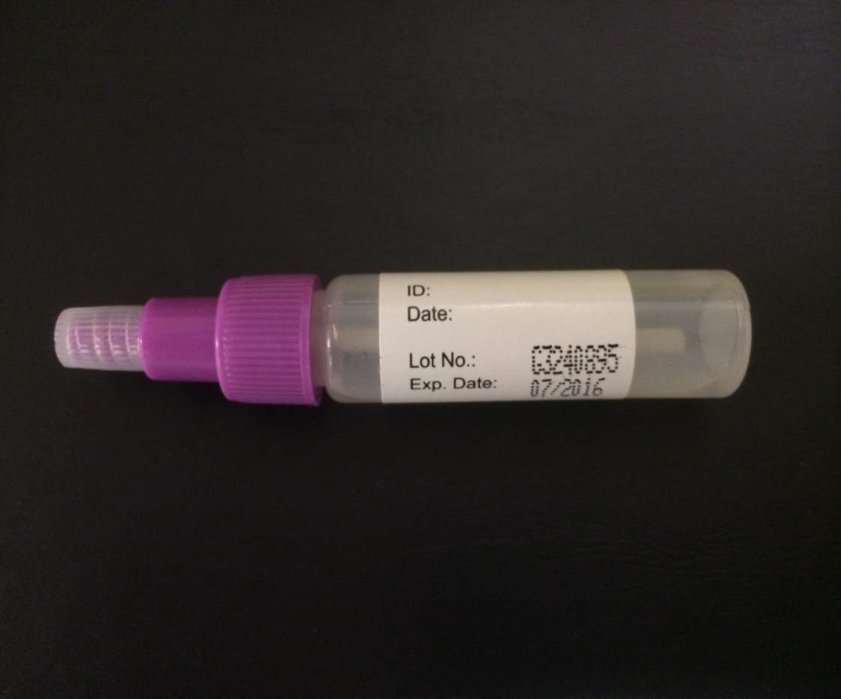
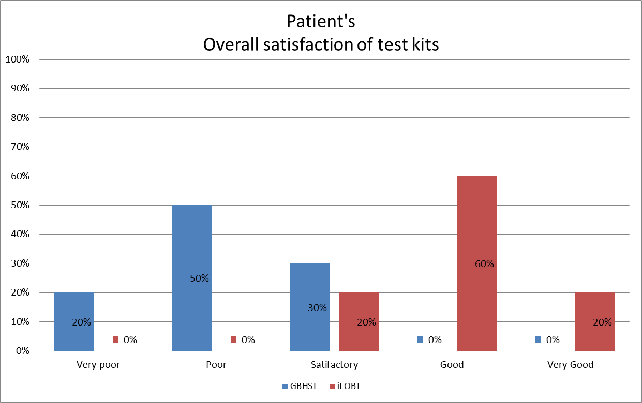
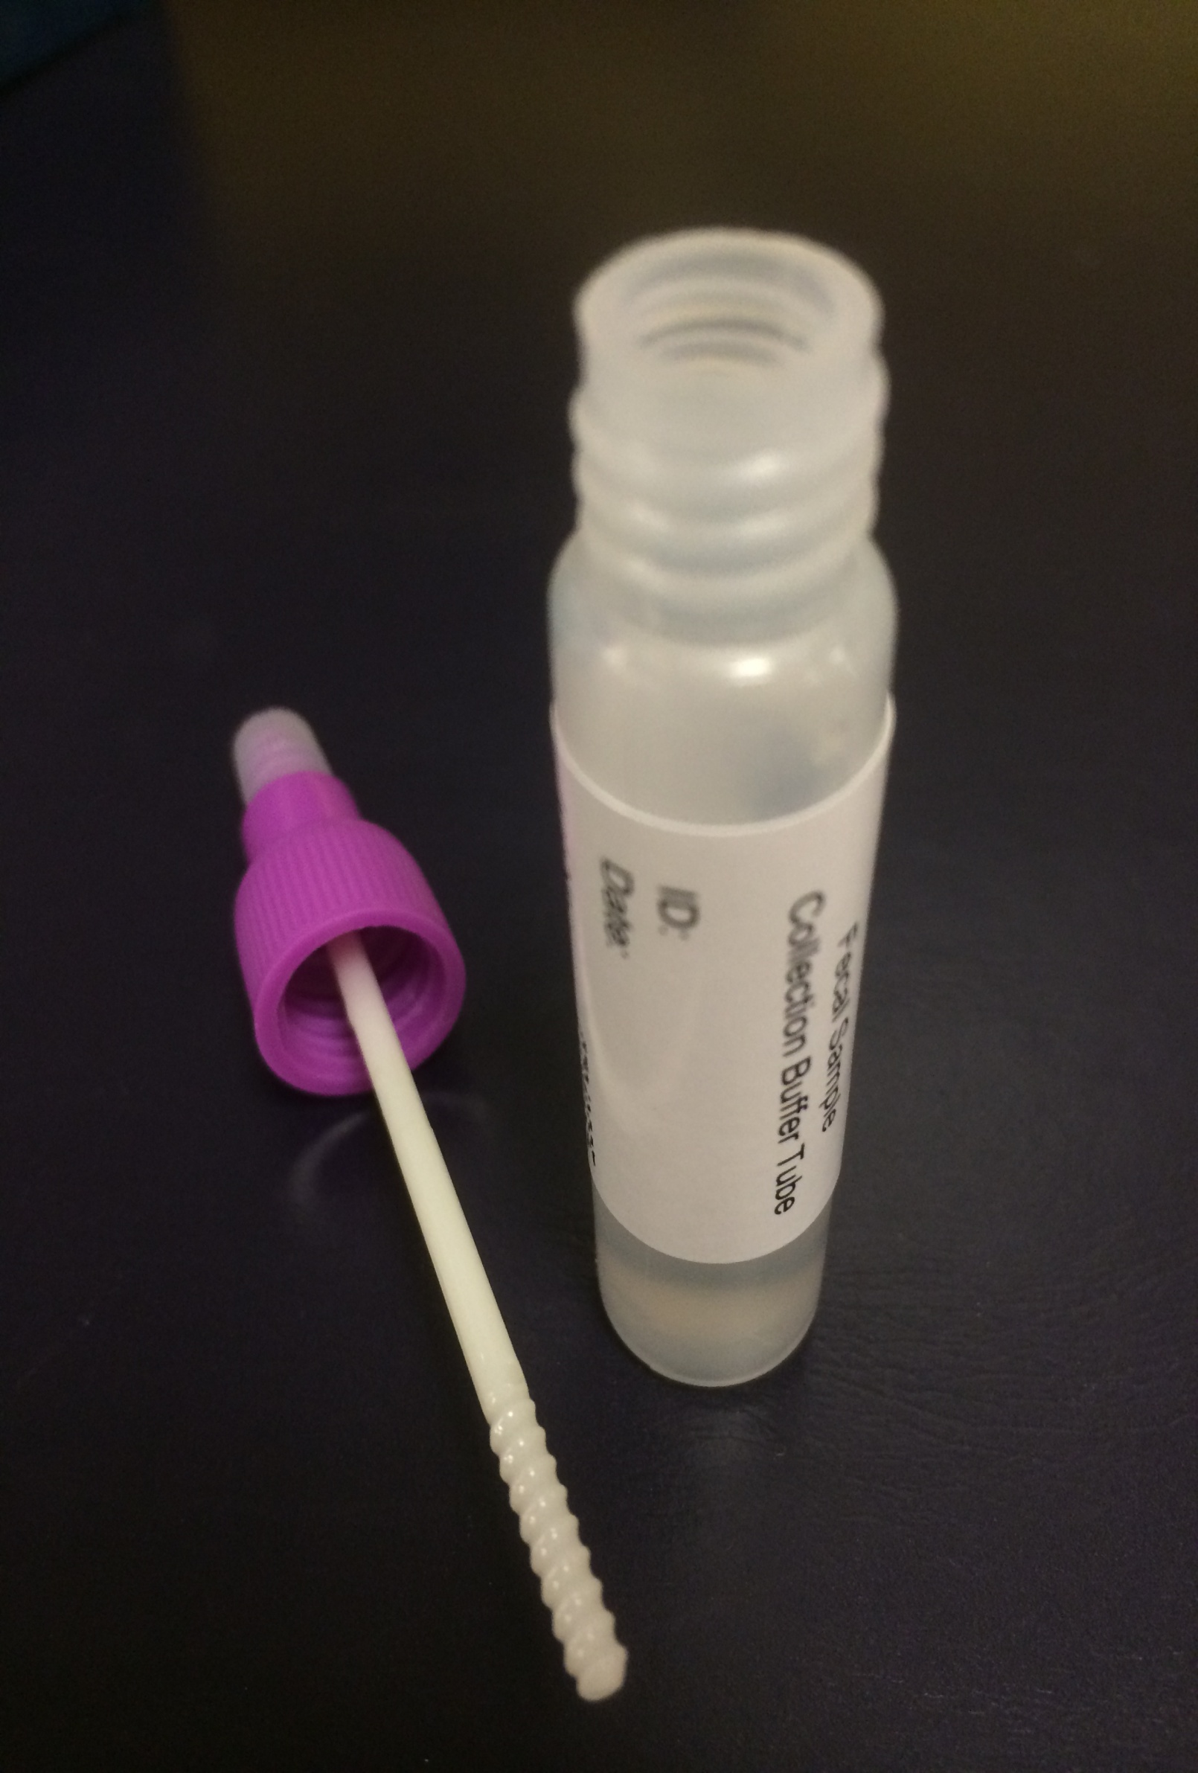
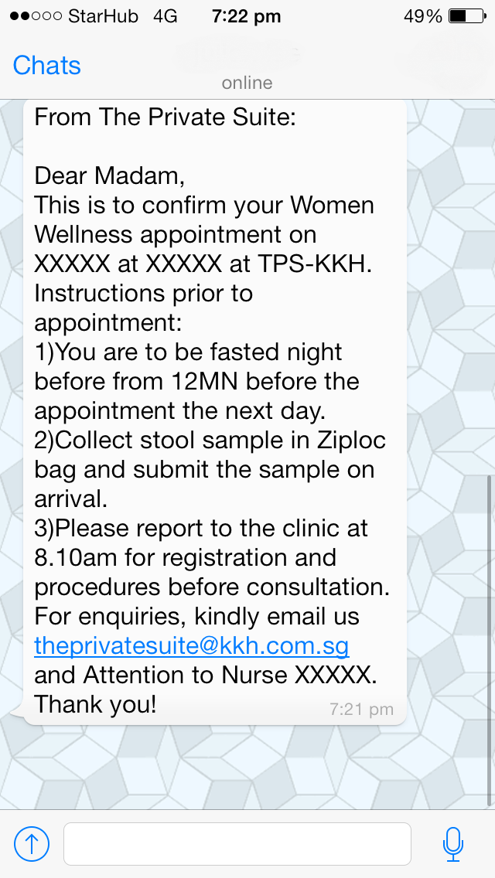
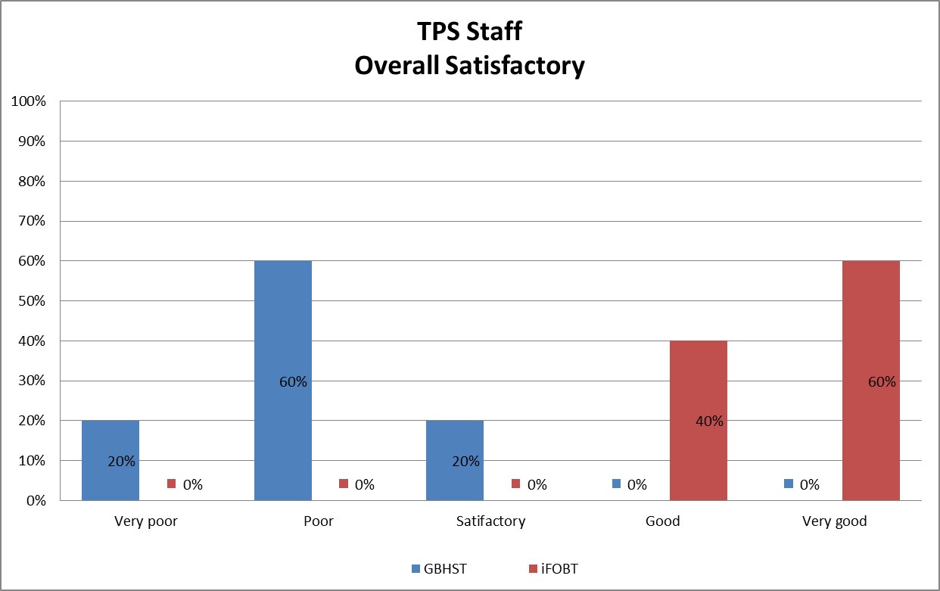
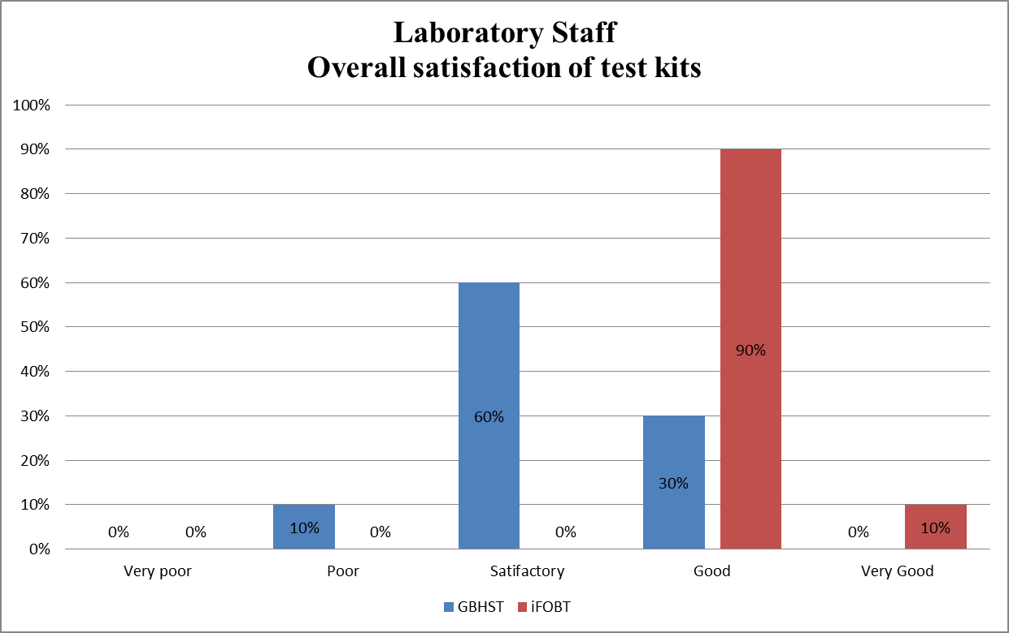
Process Improvement With Use of Hemosure Immunochemical Faecal Occult Blood Test
J.W.S Setoh, J.Y.H Lee,
G.Y Chen,L.Y.Q Kwek,
E.T.H Tan
KK Women’s and Children’s Hospital (SingHealth)
INTRODUCTION
Before November 2013, KK Women’s and Children’s Hospital (KKH) used the Guaiac-based Hemoccult Sensa test (GBHST) for Faecal Occult Blood (FOB) test for the Women Wellness Health Screening Program at The Private Suite (TPS).
iFOBT KIT
In November 2013, a new FOB test, Hemosure Immunochemical Faecal Occult Blood Test (iFOBT) was introduced. This new test employs the immunoassay method. With the introduction of the new iFOBT test kit we have addressed patient safety issues and brought improvement in FOB testing at KKH.
METHODOLOGY
Using GBHST, patients would received stool collection containers with patient identification labels by post before their appointments. At TPS, the staff would affixed test labels on the patients’ faecal containers before dispatching them to the laboratory.
In November 2013, we evaluated iFOBT and decided to replace GBHST. With the change to iFOBT, TPS reviewed it’s workflow. TPS staff now send an electronic messages to remind patients on proper stool collection using appropriate containers or Ziplock bag. At TPS each patient will be given a special iFOBT-tube containing an application stick and an extraction buffer. The patient will insert the stick into the stool sample, return the stick into the tube, cap and mix the sample with the buffer. TPS staff will then affix test ordering labels and dispatch the iFOBT-tubes to the laboratory.
A survey was carried out for the laboratory staff, the clinic staff and the patients on their use of iFOBT two months before and after its introduction.
Graph 3. TPS Patient Satisfaction survey
TPS send stool collection bottles to patient before appointment
Before
GBSHT Test Kit
After
iFOBT Test Kit
TPS send an e-SMS to patient 3 days before appointment with instruction for stool collection.
No Dietary restriction
Call patient to inform about stool collection criteria and dietary restriction
Patient did not collect stool with TPS stool container
Patient arrive at TPS with Stool
Patient arrive at TPS with Stool
Patient insert stick into the collected stool
Affix Order Labels and send specimen to the lab
Transfer stool to proper stool container
Affix CPOE Labels and send iFOBT tubes to the lab.
Fig 3. TPS Past Workflow
Fig 4. TPS Present Workflow
RESULTs
GBHST can be affected by dietary peroxidases, animal blood or ascorbic acid, patients had to avoid red meat, drugs and vitamins three days before stool collection. After collection, they had to refrigerate the containers to minimise specimen degradation. Intrinsic colour of the stool specimens can affect the interpretation of the GBHST by laboratory staff.
iFOBT detects lower levels of FOB than the GBHST (more sensitive). iFOBT result is not affected by the intrinsic faecal colour or by dietary peroxidases, animal blood or ascorbic acid. Further, the stool samples can be stored at room temperature up to fourteen days.
The change in workflow had yielded excellent feedbacks from patients, TPS staff and laboratory staff.
Patients need not wait for stool containers via mail. The collected stool specimens need not be refrigerated. Patients need not observe dietary restriction prior to testing.
Laboratory staff members are able to interpret the test more accurately with iFOBT and they experience improved ease in processing of stool specimens.
The clinic staff has simplified specimen labelling: they only need to label the iFOBT-tubes. TPS do not need to receive stool containers with leaked faecal material. The use of iFOBT-tubes has overcome the foul faecal smell in the treatment room.
Application Stick
Extraction Buffer
SAMPLE SMS
Fig 1. iFOBT Test Kit
Fig 2. TPS Sample SMS to Patient
CONCLUSION
By changing to iFOBT, we have improved the accuracy of FOB test at KKH, reduced pre-analytical errors and addressed the problems encountered with the GBHST method.
Graph1. TPS staff Satisfaction survey
Graph2. Lab staff Satisfaction survey

