Slide 1
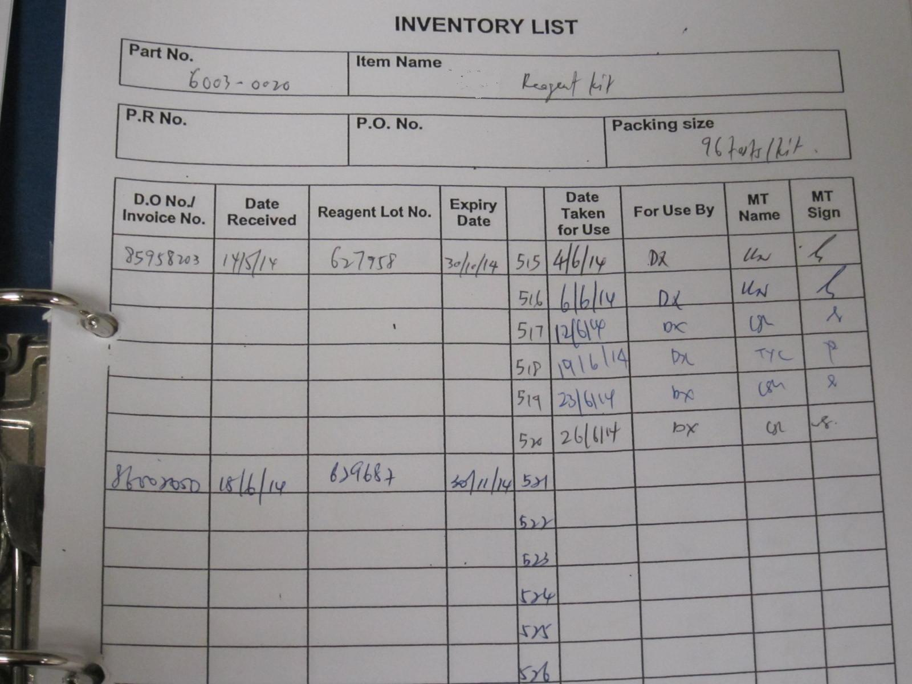
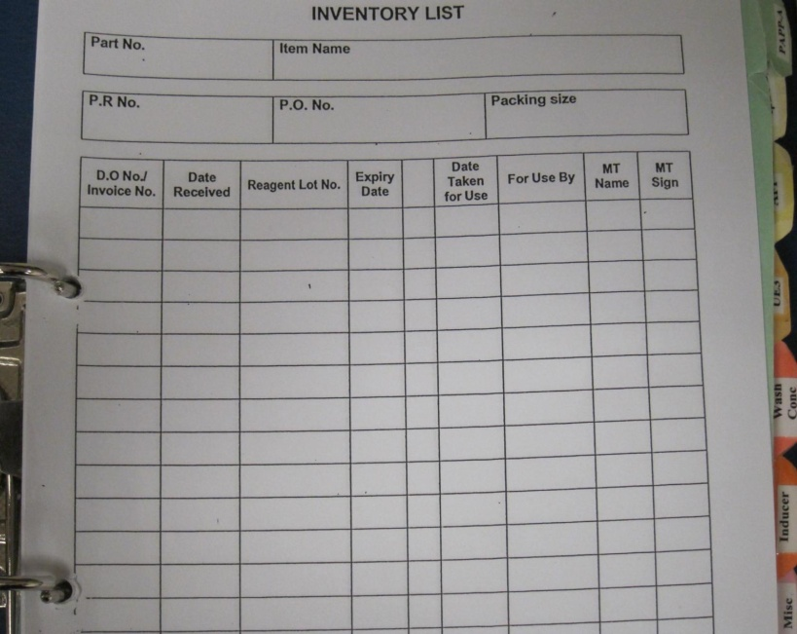
Process improvement with use of
Comed Reagent Management System
E.S.K Loh¹
J.Y.H Lee¹
R.Y.L Yong¹
J.W.S Setoh¹
1)Department of Pathology and Laboratory Medicine,
KK Women’s & Children’s Hospital, Singapore
Background
Inventory management has always been a challenge in the laboratory. Using manual inventory system (MIS) is laborious as we have numerous supplies and reagents. Stock check is done periodically to balance the availability of supplies and reagents in stock with their expiration date. This usually costs manpower and time in manual counting and order preparation.
Problems
There are many issues associated with MIS, such as incomplete or no audit trail, transcription errors, lack of compliance, paper storage, ad-hoc stock management, just-in-time orders, duplicate orders, high stock handling costs, stock wastage through expiry and high stock-on-hand operating costs.
Aim of Study
In this project, we aimed to improve the inventory management with the use of software “The Comed Reagent Management System” (CRMS) to replace the manual inventory system in KKH Biochemistry Laboratory (KKHBL).
 | MIS | CRMS
Lot Expiration Report | Staffs have to look through all the items in the inventory record in Excel or paper format and take note of the expiring or expired items. | The lot expiration report shows a specific list of items in expiry date order. From this report, the staff will know which items are expiring or expired. Items highlighted in yellow have two weeks shelf life and these should be brought to the attention for appropriate use to avoid waste. Expired item will be highlighted in red and should be booked out to waste.
Item Stock Report | Staffs have to look through all the items in the inventory record in Excel or paper format and take note of which items are low in stock. | From this report, staff can see the current stock on hand with the associated ‘MIN’ and ‘MAX’ levels for each item. Any items at or below the minimum level will be highlighted in red. Together with lot expiration report, the staff is able to quickly assess the stock level situation and prepare the order list .
Booking in and out Reports | Staffs have to look for specific item inventory record in the inventory record in Excel or paper format when tracing for the person who booked out the item. Unable to trace the one who did the recording/booking in of new items. | Booking in/out report for audit trail is customizable such as the staff can define the date range, pack ID and supplier.
Methodology
CRMS is an electronic inventory management system which provides a comprehensive audit trail for each consumable item and their lot numbers from ordering to consumption. The software is easily installed on the network PC and is accessible from several other PC terminals in the Biochemistry Laboratory.
Below is the comparison between MIS and CRMS (Tables 1 & 2):
 | MIS | CRMS
Booking In | Upon receiving new items, staff will record them into the inventory record in Excel or paper format. Staffs label them by writing sequential numbers onto the items according to the record. | After log in, staff books in the items (reagents and supplies) after receiving from the vendor. Pack ID barcoded stickers are generated and pasted on the respective items.
Booking out | Staffs have to look for the respective item inventory record, write down the date taken for use and his/her initial. | Staff will log into the CRMS, book out the required items by scanning the pack ID barcodes and click “Ok”. There will be an “Older lot in stock” alert to prompt the staff to use the older lot of item when the staff scans a item of a new lot if he/she mistakenly takes out a wrong lot of reagent.
Stock Alerts | Staffs have to look through all the items in the inventory record in Excel or paper format and take note of which items are low in stock or expiring. | When the item reaches its minimum stock level or expiring , there will be a message pop up to alert the staff immediately after log in. Staff will plan ahead to order the item so as to ensure the stock is not depleted.
Table 2. Comparison of MIS vs CRMS
Results
All the items in the laboratory were properly labelled with the printed barcodes. Staff are able to account for inventory when booking out the items by scanning the barcode labelled on the individual items. The system is able to track the minimum stock required for the individual items and the expiry dates of the existing stocks. With these features, the following improvements were achieved in the inventory process:
1) We have improved cash flow by reducing excess holding stock within the laboratory.
2) We are able to track expiry dates to ensure that none of the reagents and supplies will expire, hence preventing wastage.
3) We are able to monitor inventory closely and order appropriately to prevent reagent depletion.
Conclusion
CRMS software is useful as it is an open system based on a simple 3 step stock rotation cycle;
ORDER > BOOK IN > BOOK OUT
CRMS is an immediate solution to the many issues associated with manual stock management such as incomplete or no audit trail, transcription errors, lack of compliance. RMS resolves these issues by providing the following advantages; easy audits through an electronic, paper free system with full audit trail, user-definable parameters such as product mins and maxes which gives stable stock levels and the potential for significant waste reduction.
There were positive feedbacks from the staff. The CRMS software is user friendly and its implementation has benefited the laboratory significantly by improving our inventory management.
Table 1. Comparison of MIS vs CRMS

